Slide 1
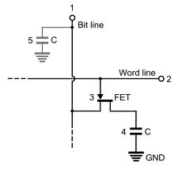
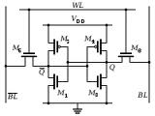
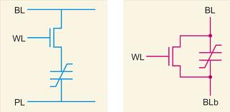
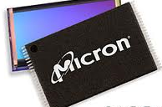

EECS 373
Design of Microprocessor-Based Systems
Prabal Dutta
University of Michigan
Lecture 9: Memory Technologies
Oct 4, 2011

Slide 2
Announcements
Homework #1 status
Simulator roadmap
Course feedback

Slide 3
Mid-course corrections:
What’s not going well? How can we do better?

Slide 4
Outline
Minute quiz
Announcements
Memory Landscape
Memory Architecture
Non-volatile Memories
Volatile Memories

Slide 5
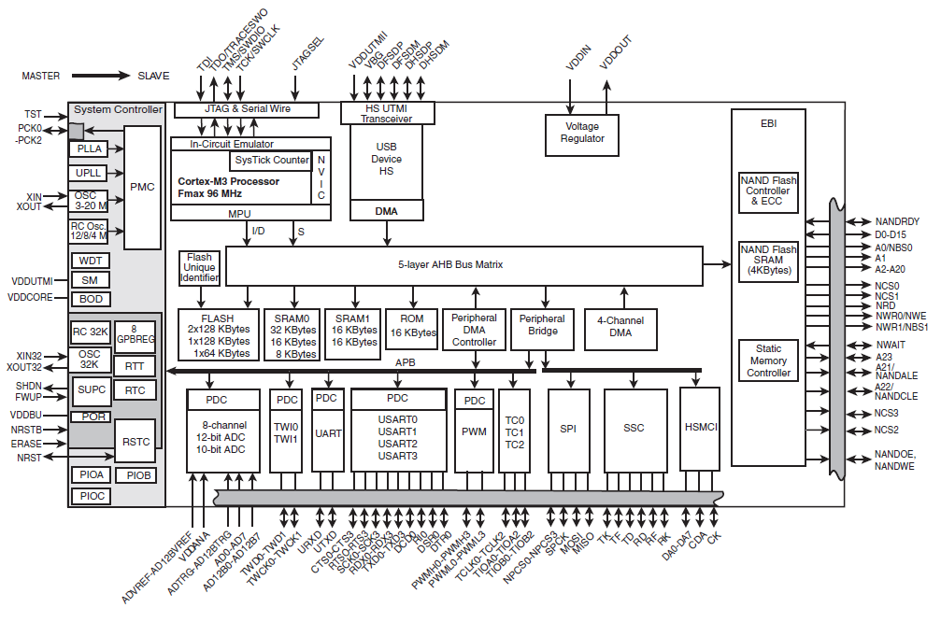
External memory attaches to the processor via the external memory controller and bus
Atmel SAM3U

Slide 6
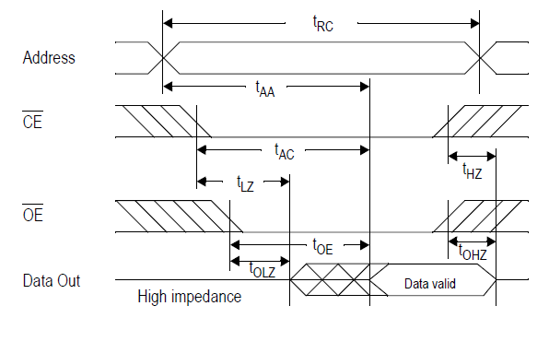
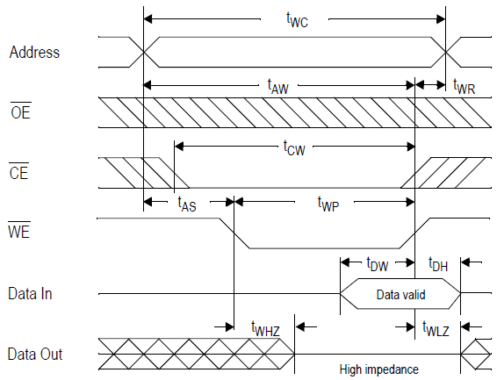
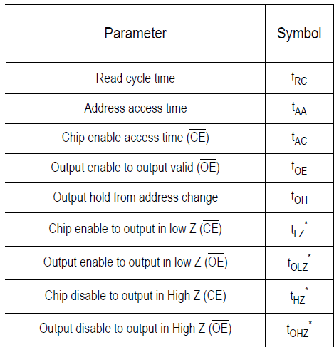
External memory bus transactions
Read and write transactions
Interfacing/handshaking
Timing constraints
Access speeds
Wait states

Slide 7
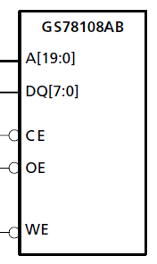
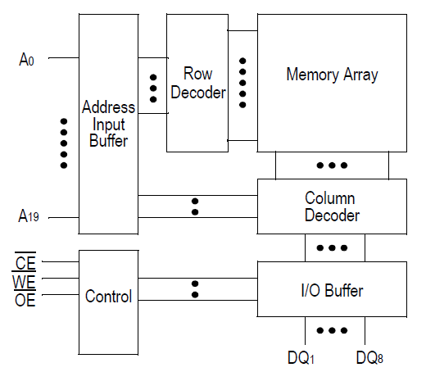
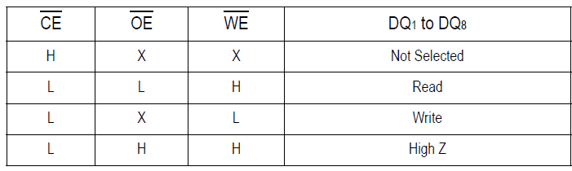
Interface and architecture of external memory devices
A: 20-bit address bus
DQ: 8-bit data bus
CE#: chip enable
WE#: write enable
OE#: output enable

Slide 8
Basic categories of memory
Read-Only Memory (ROM)
  Can only be read (accessed)
  Cannot be written (modified)
  Contents are often set before ROM is placed into the system
Random-Access Memory (RAM)
  Can be read/written
  Term used for historical reasons
  Technically, ROMs are also random access
Volatile memory
  Loses contents when power is lost
  Often stores program state, stack, and heap
  In desktop/server systems, also stores program executable
Non-volatile memory
  Retains contents when power is lost
  Used for boot code in almost every system

Slide 9
Memory technologies landscape
 | Volatile | Non-Volatile
RAM | Static RAM (SRAM) Dynamic RAM (DRAM) | EEPROM Flash Memory FRAM MRAM BBSRAM
ROM | n/a | Mask ROM PROM EPROM

Slide 10
Choosing the right memory requires balancing many tradeoffs
Volatility: need to retain state during power down?
Cost: wide range of absolute $ and $/bit costs
Organization: 64Kbx1 or 8Kbx8?
Interface
  Serial or serial or parallel or parallel or parallel?
  Synchronous or asynchronous?
Access times: critical for high-performance
Modify times: critical for write-intensive workloads
Erase process: at wire-line speed or 5 minutes in UV?
Erase granularity: word, page, sector, chip?

Slide 11
Outline
Minute quiz
Announcements
Memory Landscape
Memory Architecture
Non-volatile Memories
Volatile Memories

Slide 12
Internal organization of memory is usually an array
Mem
Cell
Mem
Cell
Mem
Cell
Mem
Cell
word
lines
Mem
Cell
Mem
Cell
Mem
Cell
Mem
Cell
Different memory
types (e.g. SRAM vs
DRAM) are
distinguished by the
technology used to
implement the
memory cell, e.g.:
SRAM: 6T
DRAM: 1T/1C
Mem
Cell
Mem
Cell
Mem
Cell
Mem
Cell
Mem
Cell
Mem
Cell
Mem
Cell
Mem
Cell
What should be
the aspect ratio
(# rows vs #cols)?
bit lines

Slide 13
Physical (on-chip) memory configuration
Physical configurations are typically square
Square minimizes length of (word line + bit line)
Shorter length means
  Shorter propagation time
  Faster data access
  Smaller t_{rc} (read cycle time)
Exercise: Assume n² memory cells configured as
  n-by-n square array. What is the worst case delay?
  n²-by-1 rectangular. What is the worst case delay?
Exercise: Does wire length dominate access time?
  Assume propagation speed on chip is 2/3 c (2x10^8 m/s)
  Assume 1Mbit array is 1 cm x 1 cm

Slide 14
Logical (external) memory configuration
External configurations are tall and narrow
  More address lines (12 to 20+, typically)
  Fewer data lines (8 or 16, typically)
The narrower the configuration
  The greater the pin efficiency
  Adding one address pin cuts data pins in half
  The easier the data bus routing
Many external configurations for given capacity
  64 Kb = 64K x 1 (16 A + 1 D = 17 pins)
  64 Kb = 32K x 2 (15 A + 2 D = 17 pins)
  64 Kb = 16K x 4 (14 A + 4 D = 18 pins)
  64 Kb = 8K x 8 (13 A + 8 D = 21 pins)
  64 Kb = 4K x 16 (12 A + 16 D = 28 pins)
  64 Kb = 2K x 32 (11 A + 32 D = 43 pins)

Slide 15
Supporting circuitry is needed to address memory cell and enable reads and writes
Memory
Array
16 bits
(4 x 4)
A0
A1
A2
2:4 decoder
Control signals
Select chip
Select memory cell
Control read/write
Map internal array to
external configuration
(4x4 → 16x1)
A3
4:1 mux/demux
OE#
CS#
WE#
D0

Slide 16
Refresher on the memory-bus interface
Chip Select (CS#)
  Enables device
  Ignores all other inputs if CS# is not asserted
Write Enable (WE#)
  Enables write tri-state buffer
  Store D0 at specified address
Output Enable (OE#)
  Enable read tri-state buffer
  Drive D0 with value at specified address

Slide 17
Outline
Minute quiz
Announcements
Memory Landscape
Memory Architecture
Non-volatile Memories
Volatile Memories

Slide 18
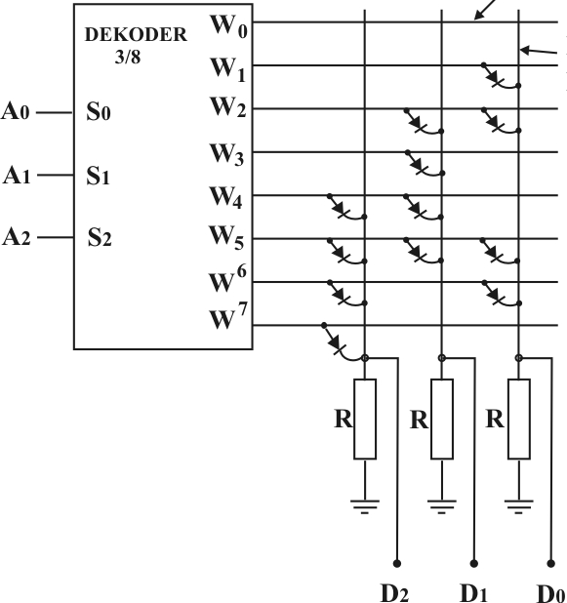
Mask ROM
The “simplest” memory technology
Presence/absence of diode at each cell denote value
Pattern of diodes defined by mask used in fab process
Contents are fixed when chip is made; cannot be changed
High upfront setup costs (mask costs)
Small recurring marginal costs
Good for applications where
  Cost sensitivity drives design
  Upgrading contents not an issue
  e.g. boot ROM, CPU microcode
Exercise:
  What “value” does a diode encode?
  What are the contents:
    Where A<2:0> = 101?
    Where A<2:0> = 110?
word
lines
Bit
lines

Slide 19
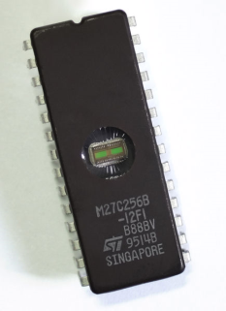
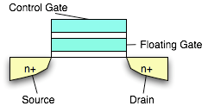

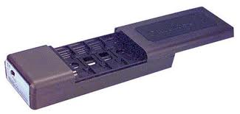
EPROM
Erasable Programmable Read-Only Memory
Constructed from floating gate FETs
  Charge trapped on the FG erases cell
  High voltage (13V +) applied to the control gate
    “Writes” the cell with a 0
    Allows FG charge to be dissipated
Erasing means changing form 0 → 1
  Uses UV light (not electrically!)
  Electrons are trapped on a floating gate
Writing means changing from 1 → 0
Erase unit is the whole device
Retains data for 10-20 years
Not used much these days
Costly because
  Use of quartz window (UV transparent)
  Use of ceramic package
PROM (or OTP) is same, just w/o window

Slide 20
Flash Memory
Electrically erasable (like EEPROM, unlike EPROM)
Used in many reprogrammable systems these days
Erase size is block (not word); can’t do byte modifications
Erase circuitry moved out of cells to periphery
  Smaller size
  Better density
  Lower cost
Reads are like standard RAM
Can “write” bits/words (actually, change from 1 → 0)
  Write cycle is O(microseconds)
  Slower then RAM but faster than EEPROM
  To (re)write from 0 → 1, must explicitly erase entire block
    Erase is time consuming O(milliseconds to seconds)
Floating gate technology
  Erase/write cycles are limited (10K to 100K, typically)

Slide 21
Outline
Minute quiz
Announcements
Memory Landscape
Memory Architecture
Non-volatile Memories
Volatile Memories

Slide 22
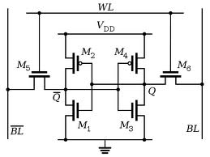
Static RAM
SRAMs are volatile
Basic cell
  Bistable core
    4T: uses pullup resistors for M2, M4
    6T: uses P-FET for M2, M4
  Access transistors
  BL, BL# are provided to improve noise margin
6T is typically used (but has poor density)
Fast access times O(10 ns)
Read/write speeds are symmetric
Read/write granularity is word

Slide 23
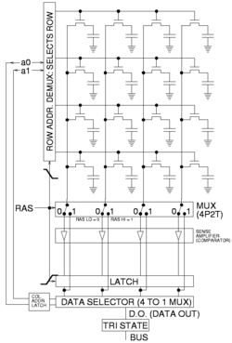
Dynamic RAM
Requires only 1T and 1C per cell
Outstanding density and low cost
Compare to the 6T’s per SRAM cell
Cost advantage to DRAM technology
Small charges involved → relatively slow
  Bit lines must be pre-charged to detect bits
  Reads are destructive; internal writebacks needed
Values must be refreshed periodically
  Prevents charge from leaking away
  Complicates control circuitry slightly

Slide 24
Questions?
Comments?
Discussion?

